Slide 1

Stephen Cook: The Research Software Engineering Group

Slide 2
What is a Research Software Engineer?
Research Software Engineers (RSEs) have a research background and strong software engineering skills.
RSEs can assist with complex and bespoke software needs in your research projects.​
About the RSE group:​
Permanent members of staff who can be costed into research applications for portions of time as needed
Soon to be 9 RSEs, skilled in a variety of programming languages​
Focus on reproducibility and openness in research​

Slide 3
What can we help with?
Pipelines for data analysis and visualisation​
Bespoke software tools for enabling research, e.g. laboratory experiments​
Maintenance, development and extension of numerical models​
Developing reusable software frameworks and libraries based on your research​
Optimising code to run on HPCs​
Web/mobile apps and other UIs
Training on programming skills for researchers and PGRs
Coding for Reproducible Research – annual, free training for all staff
bespoke workshops on demand
Much more! Please get in touch

Slide 4
How to work with us
Fill in a short form with an overview of your project​
We’ll contact you within 48 hours for a chat about the scope of the work and the RSE time required. ​
When funding is confirmed for your project, we’ll firm up the schedule for when an RSE can start work.​
The RSE will form part of your research group while they are working on your project.​
The rest of the RSE group can also help support the RSE.​

Slide 5
Building an RSE community
The RSE group sits within a wider ecosystem of RSEs and aligned research computing infrastructure roles across the university
We want to build an inclusive and supportive environment for RSEs at Exeter
Opportunities for Knowledge exchange and peer support:
Join our monthly RSE networking event – all are welcome!
Research Software Engineer Community Social
Fortnightly RSE Journal club
Ask questions and get help on your coding problem via the RSE Slack group: IDSAI-RF-RSE

Slide 6
More information
Contact:
rse-group@exeter.ac.uk or K.J.Finch@exeter.ac.uk
RSE Overview:
https://www.exeter.ac.uk/idsai/team/researchsoftwareengineers/
Initial enquiry form to discuss support for projects: https://bit.ly/3jhboXW
Ask us a question and keep up to date via RSE Slack: IDSAI-RF-RSE

Slide 7
Some examples of our work

Slide 8
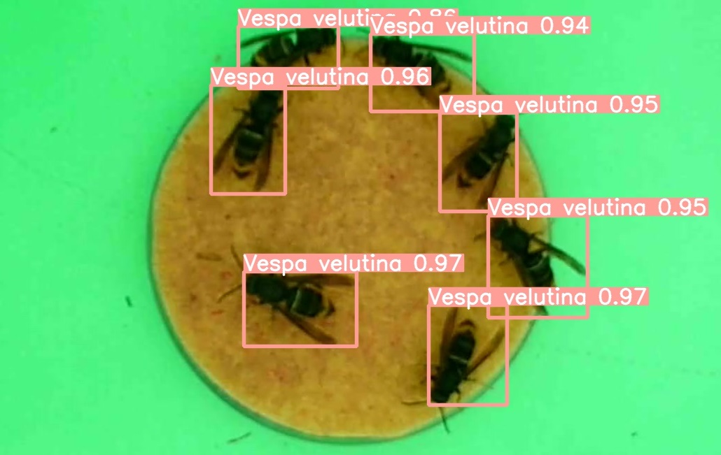
VespAI – Object detection for Hornet Detection
2023 - Juliet Osborne (Penryn PI), Stephen Cook (RSE)
Aim: A system which can automatically identify Asian Hornets from a baited camera-trap.
RSE Contributions:
Supported the researchers developing the system towards a market product.
Ensure code adheres to software best practices (notably testing, documentation and consistent deployment)
Image from Vesp-AI documentation – Andrew Corbett

Slide 9


Cornwall FLOW Accelerator
Lars Johanning (Exeter PI), Celtic Sea Power (Industrial Collaborator), Fliss Guest (RSE)
Aim: To underpin the deployment of 1000MW worth of offshore wind by 2030, developing a low carbon footprint approach to floating offshore wind (FLOW) operations.
RSE Contributions:
Support the development of the simulator.
Integrate the existing Operation & Maintenance (O&M) Module.
Develop a graphical user interface.
Advise on best practices.
Retrieved from https://www.oceannews.com/news/energy/emerging-opportunity-for-floating-offshore-wind-in-the-celtic-sea.
Copyright 2022 by Technology Systems Corporation.
Deliverables:
A fully-functioning simulator with a visually appealing graphical user interface that enables the user to compare strategies to FLOW.

Slide 10


Global Carbon Budget Office (Prof. Pierre Friedlingstein) – Dr Thomas Hawes
The Aims
Increase GCB data accessibility and visualisation, esp. outside academia
Streamline annual production of GCB report
The Deliverables
New data website for data access and visualisation
Improve the quality of scripts used to autogenerate GCB report materials (figures, tables, spreadsheets)
The Impact
Greater influence of GCB report within public e.g. policy makers
Cleaner, more transparent codebase – easier to maintain/extend with less manual intervention

Slide 11
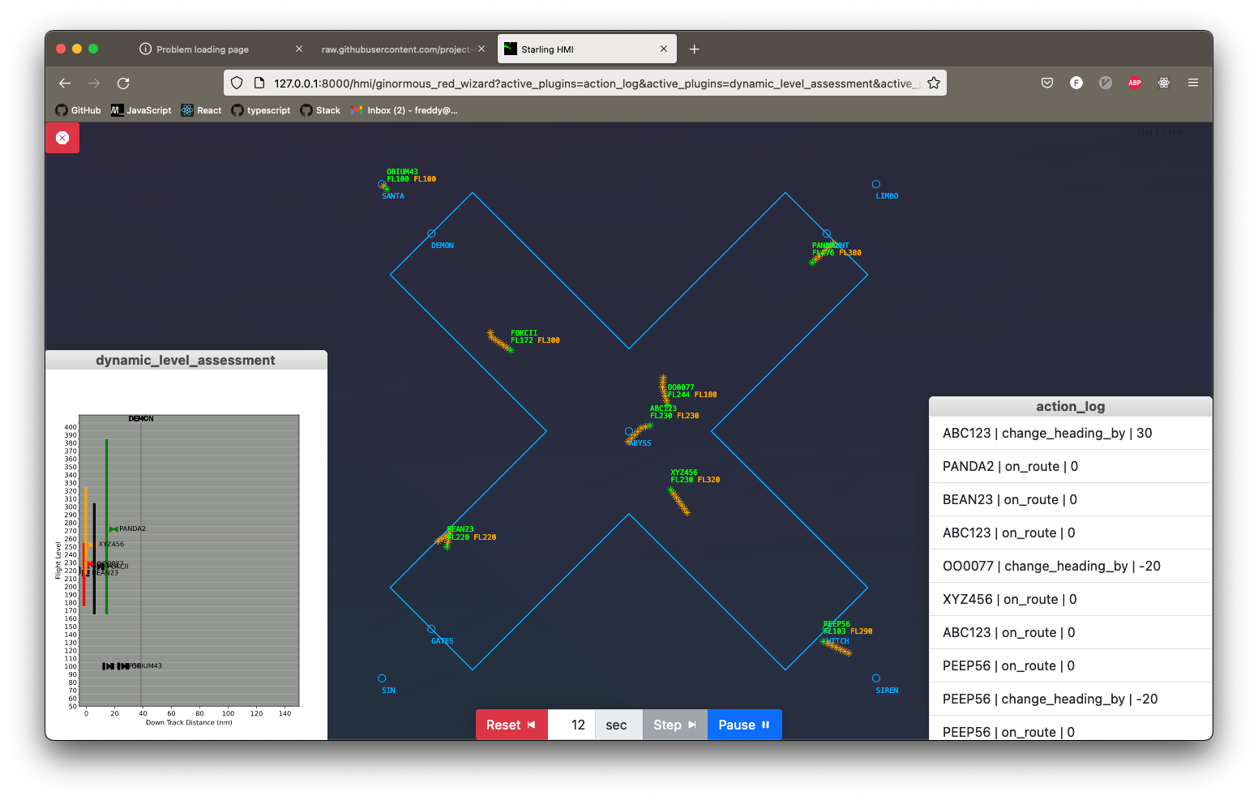
Freddy Wordingham- Bluebird-Starling Tim Dodwell (PI), NATS & Turing (External Collaborators)
Project ambition:
To deliver the world’s first AI system to control a section of UK airspace in live trials.
RSE contributions
Library prototyping
Developing web applications
Encouraging and maintaining best practices:
Code readability
Auto formatting
Continuous integration
Unit testing

Slide 12

Quantum Machine Learning for Fraud Detection
Oleksandr Kyriienko (Exeter PI), Einar Búi Magnússon (HSBC PI), Fliss Guest (RSE), Omar Jamil (RSE)
Aim: To scope the potential of quantum machine learning methods for fraud detection to inform the quantum effort at HSBC.
RSE Contributions:
Supported the PIs during the development of quantum machine learning algorithms.
Wrote code to benchmark the quantum algorithms and their classical counterparts in both Julia and Python.
Retrieved from https://pennylane.ai/qml/whatisqml.html.
Copyright 2019 by Xanadu.
Outcomes:
Quantum algorithm results were very promising - a publication is being prepared and the results will feed into HSBC strategy.
Prompted discussion – “collaboration proved really valuable”.

